Slide 1

Battle of Attrition and Salary
Dylan Scott
14/16/2021
Notes:
Thanks for meeting today
We will be discussing Attrition and salary, both very important and expensive topics for many top companies
Let’s get into it

Slide 2
Agenda
What are the top factors that lead to attrition?
Can we predict employee turnover and how well?
What factors impact employees pay?
Can we predict monthly income and how well?
Notes:
Ultimately, we’d like to answer these 4 questions
Top factors that lead to attrition and can we predict turnover or possibly lessen that strain on the company if we see those predictors
We’d also like to looks at salary which many see as the only factor in attrition but as we will see it is not the only factory
Lastly, can we anticipate someone's monthly salary and which metrics are important in that prediction?

Slide 3

Data Overview
19 Continuous variables
17 Categorical variables
8 Ordinal
9 Nominal
0 Missing values with
36 Total variables
870 Observations
Notes:
In our data we saw 36 total variables with 870 observations
We had no missing values which is great
Of those 36 variables we had 19 continuous variables
And 17 categorical variables
Which we further broke into 8 ordinal and 9 nominal variables

Slide 4
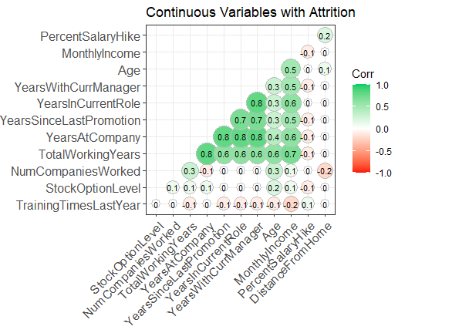
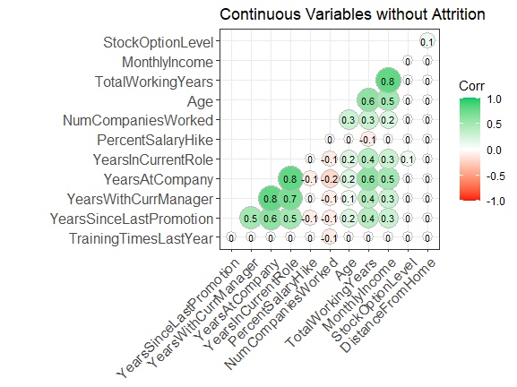
Heatmap Correlations

Slide 5
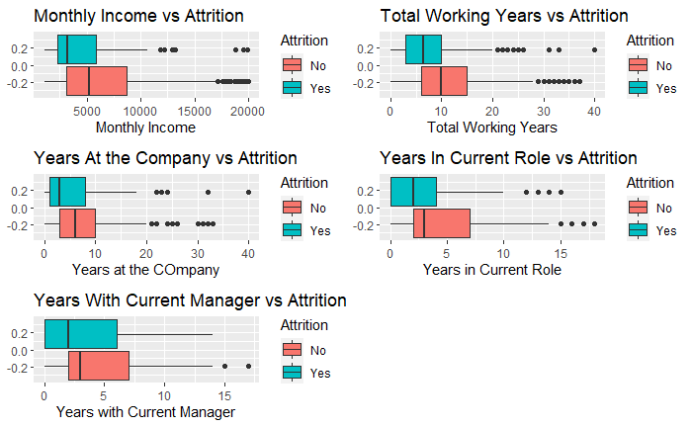
Attrition vs. Continuous Variables
Box plots were used to determine a difference in outcome.
Two sample T-Tests were used to determine a difference in means.
We want to avoid variables that explain the same thing.
Variable | T.Test.pvalue
MonthlyIncome | 2.412488e-07
TotalWorkingYears | 6.595682e-07
YearsInCurrentRole | 1.522152e-06
YearsWithCurrManager | 5.084229e-06
YearsAtCompany | 2.563021e-04
Notes:
What we are looking to test here is a difference in outcomes between these varables
In our innital test of the continuous varables we found these 5 varables to have the highest probability of impacting attrition
Two sample t tests were used
However, something we want to avoid in a predictive model is colineararity where varables look related to eachother as well as the outcome static
Among these varalbes we determined that many of them had some collinearity for example someone who has worked many years is likely to have a high years at the company, years with current manager and years in current role
For this reason we won’t be using all these varables in our model later on

Slide 6
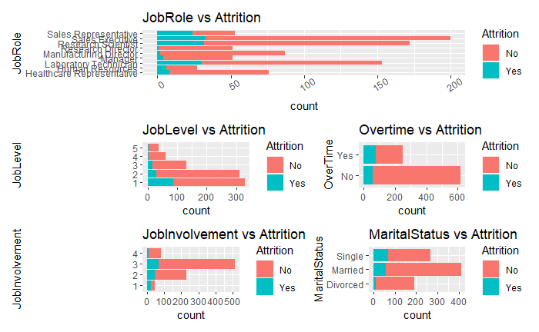
Categorical Variables
Bar charts were used to show the count of employees who left in that category.
Once again, we have out top 5 P-value .
Variable | Chisq.pvalue
JobLevel | 2.332981e-15
OverTime | 6.595682e-07
JobInvolvement | 5.211041e-09
JobRole | 3.646836e-10
MaritalStatus | 3.378946e-08
Notes:
Here we used the P value achieved from our chi square test because:

Slide 7
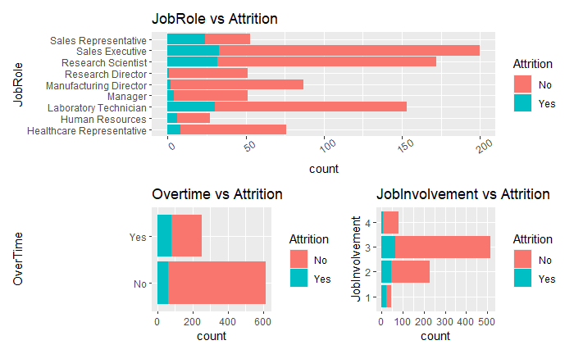
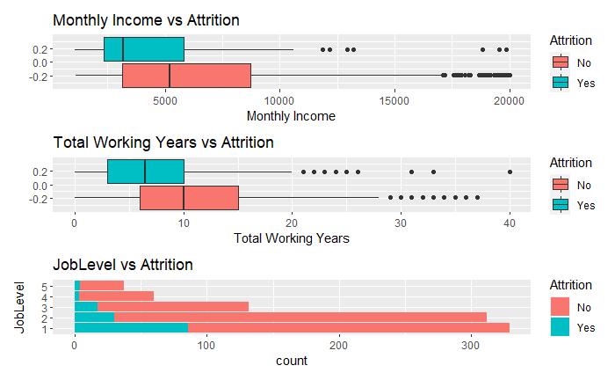
Variables used to Predict Attrition
Accuracy : 89%
Sensitivity : 93%
Specificity : 62%
Notes:
Why did you remove marriage

Slide 8
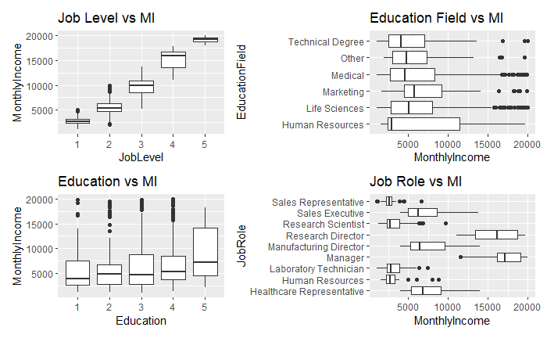
Salary – Categorical Variable's
We looked at 4 variables
Job level shows a strong linear pattern

Slide 9
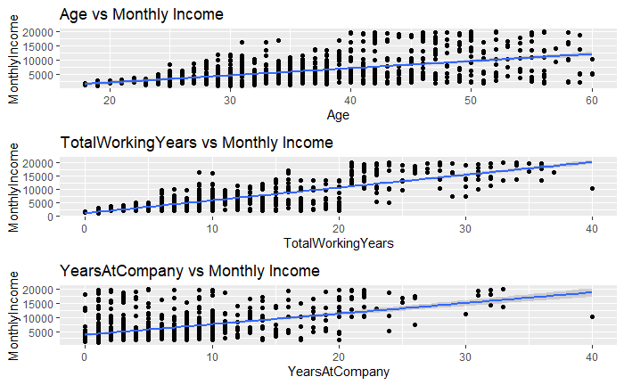
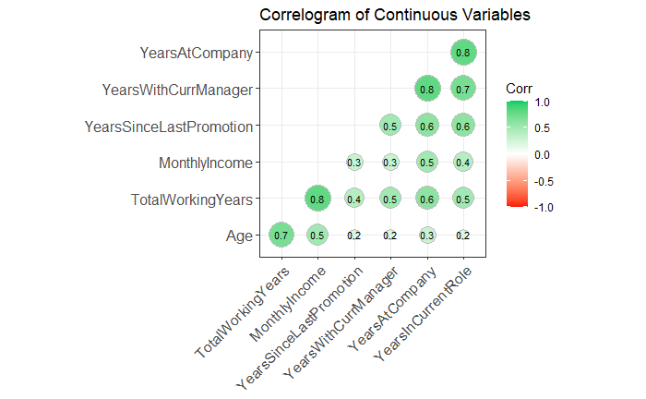
Salary – Continuous variables
The larger the dot the more correlation between the variables
Age and total years work my have some dependence
Years at the company shows a different story from age and working years
Notes:
Staying at a company longer isn’t very well rewarded

Slide 10
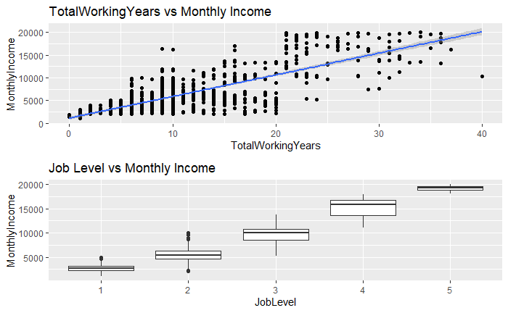
Salary Prediction
Two variables selected
R² : .92
RMSE $1261

Slide 11
Thank You
Github https://github.com/scottdyl/CaseStudy2DDS
Email Drscott@smu.edu

